Slide 1
How do the performance of a Conformal Predictor and its underlying algorithm relate?
Giovanni Cherubin
@gchers
COPA 2023

Slide 2
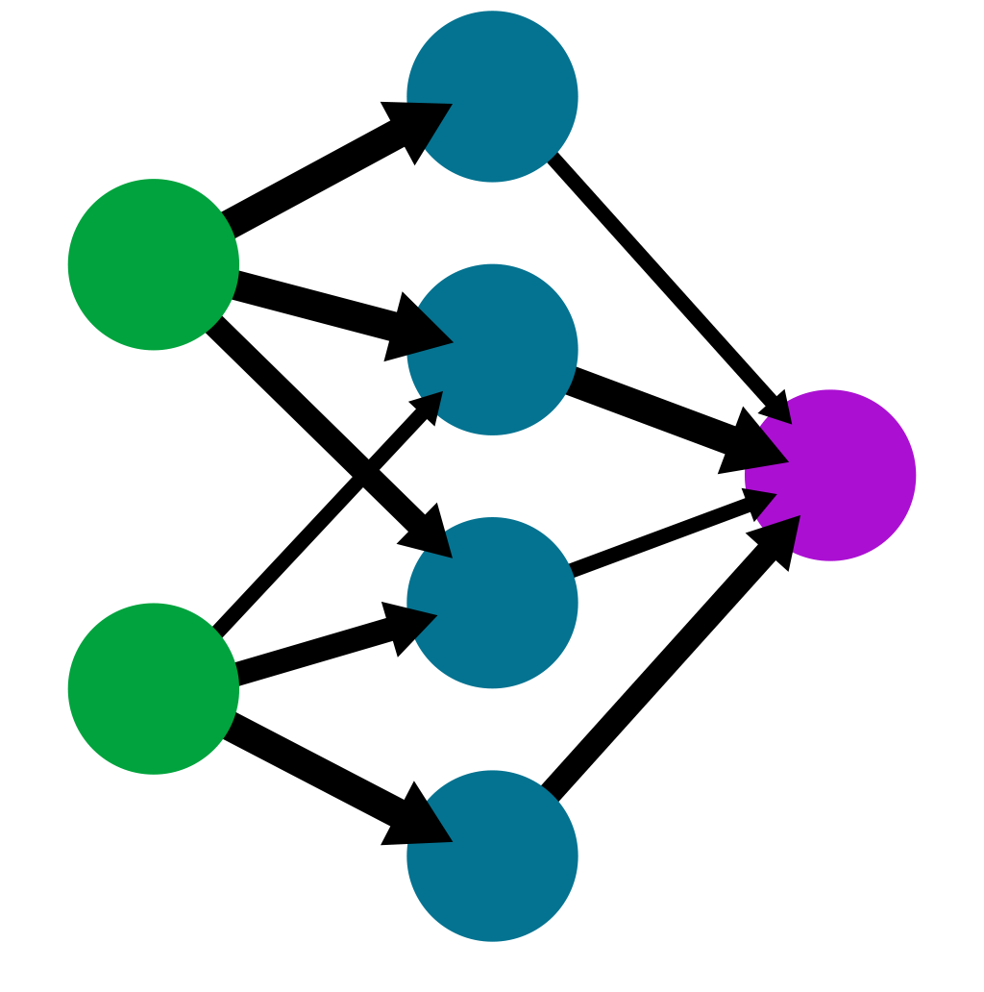
CP pipeline
Non-conformity measure
g:
CP algorithm
(outputs p-values)
y | 0 | 1 | 2 | 3 | 4 | 5 | 6 | 7 | 8 | 9
p | 0.2 | 0 | 0 | 0.1 | 0.1 | 0.8 | 0.7 | 0 | 0.2 | 0.1
Data

Slide 3
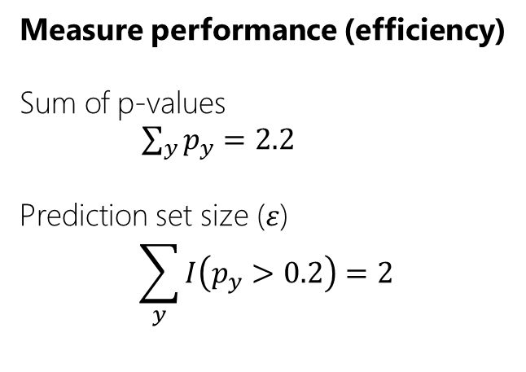
CP pipeline
Non-conformity measure
g:
CP algorithm
(outputs p-values)
y | 0 | 1 | 2 | 3 | 4 | 5 | 6 | 7 | 8 | 9
p | 0.2 | 0 | 0 | 0.1 | 0.1 | 0.8 | 0.7 | 0 | 0.2 | 0.1
Measure performance (efficiency)
Sum of p-values
$\sum_{y}{p_{y}=2.2}$
Prediction set size ($ε$)
$$\sum_{y}{I\left(p_{y}>0.2\right)=2}$$
Data
Vovk, Fedorova, Nouretdinov, Gammerman. Criteria of efficiency for conformal prediction.

Slide 4

CP pipeline
Non-conformity measure
g:
How does the performance of the CP relate to that of the underlying classifier ($g$)?
CP algorithm
(outputs p-values)
y | 0 | 1 | 2 | 3 | 4 | 5 | 6 | 7 | 8 | 9
p | 0.2 | 0 | 0 | 0.1 | 0.1 | 0.8 | 0.7 | 0 | 0.2 | 0.1
Measure performance
Sum of p-values
$\sum_{y}{p_{y}=2.2}$
Prediction set size ($ε$)
$$\sum_{y}{I\left(p_{y}>0.2\right)=2}$$
Data
Vovk, Fedorova, Nouretdinov, Gammerman. Criteria of efficiency for conformal prediction.

Slide 5
Coarse nonconformity measures
For an underlying classifier $g$, define:
$$A\left(\left(x, y\right), D\right)=I(g_{D}\left(x\right)≠y)$$

Slide 6
Results for coarse nonconformity measures (1/2)
Criterion 1: Sum of p-values is proportional to the expected risk of the classifier
$R_{g}=E\left[g\left(X\right)≠Y\right]$

Slide 7
Results for coarse nonconformity measures (2/2)
Criterion 2: The prediction set size is optimal (i.e., =1) for
$ε≥\frac{L−1}{L}$
L: number of labels.
Holds for large calibration set size N, as a consequence of:

Slide 8
TL;DL & Future directions
CP performance for coarse nonconformity measure is directly related to error rate of underlying model.
Can we prove the same for non-coarse nonconformity measures (e.g., posterior probabilities, generic losses…)?
Can this help to predict the performance of CP in practice?
Can this help to understand what is a good efficiency criterion?
Deeper understanding of the connection between CP & traditional learning.

